Slide 1
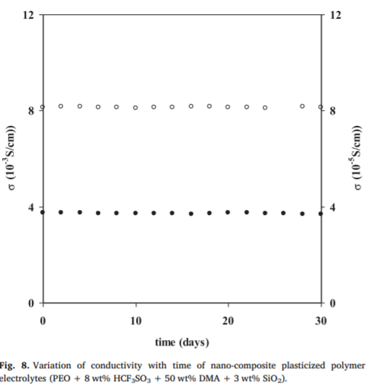
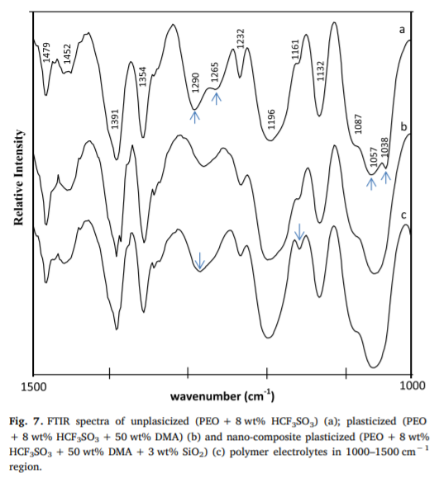
The increase in conductivity has been explained to be due to dissociation of ion aggregates with the addition of plasticizer, which has also been supported by FTIR studies. The interaction between constituents of these polymer electrolytes has been studied by using FTIR studies FTIR studies have been carried out to check the formation of ion aggregates at higher acid concentration and its dissociation with the addition of plasticizer, which leads to increase in conductivity FTIR spectra of the samples were recorded by Perkin Elmer FTIR spectrometer at room temperature. FTIR results indicate that ion aggregates are present in unplasticized polymer electrolytes at high acid concentrations (8 wt %) alongwith the presence of free ions RESULTS The increase in conductivity with the addition of plasticizer has been explained due to dissociation of ion aggregates, which has also been supported by FTIR studies
Ionic conductivity, FTIR and thermal studies of nano-composite plasticized proton conducting polymer electrolytes

